Slide 1
PROJECT REPROT TEMPLATE INDIA’S AGRICULTURAL CROP PRODUCTION ANALYSIS (1997-2021)
Dr. NALLIKUPPUSAMY ARTS COLLEGE., THANJAVUR-03
FACULTY MENTOR : MS.P. SHANMUGA PRIYA M.SC. M.Phil.,
Project done by
M.ABINAYA - TEAM LEADER
S.ABINAYASRI – TEAM MEMBER
M.BAVATHARANI – TEAM MEMBER
M.DHIVYA – TEAM MEMBER

Slide 2
INTRODUCTION
Agriculture was the first occupation of man. Many towns cities and grew around centers of agricultural production.
Early people domesticated the wild variety of plants to grow food crops like barley. Peas , Lentils, flat and wheat.
Agriculture in an economic activity, the economic activities are grouped into four main categories primary, secondary tertiary, and quarterly.

Slide 3
PURPOSE OF INDIA’S AGRICULTURAL CROP PRODUCTION
Agriculture in India is important for the development of the industrial sector and for trading purposes.
Agricultural product like tea, coffee etc., are some of the most edible and textiles of India contribute to many parts of the total export from the counting.

Slide 4

EMPATHY MAP

Slide 5
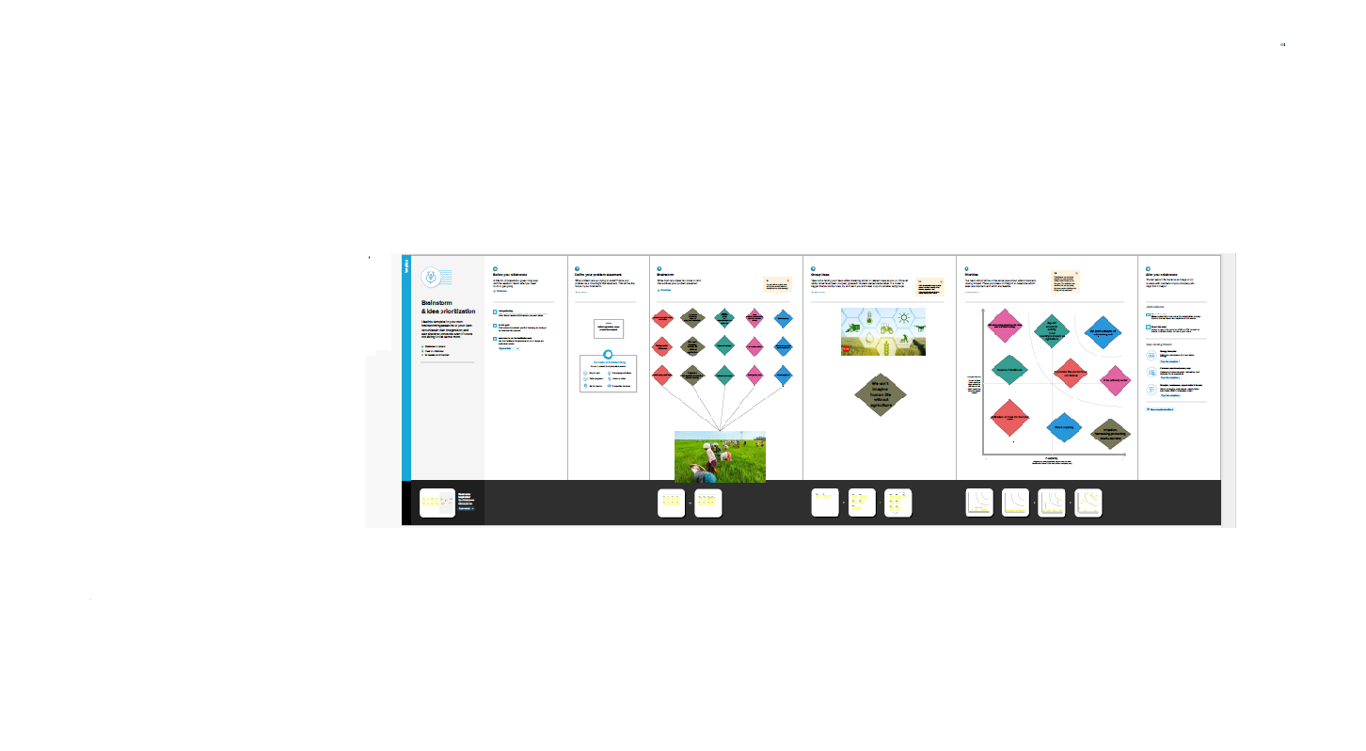
BRAINSTROMING MAP

Slide 6
ADVANTAGE
NATURAL ENVIRONMENT
Organic farming usually goes down in a natural environment. Unnecessary enclosures are not used for the crops or plants
.
NO CHEMICAL
Unlike any other procedure, organic farming does not involve any artificial sources like chemicals to drive away pests or to speed up the process of farming there chemicals are often used in commercials.

Slide 7
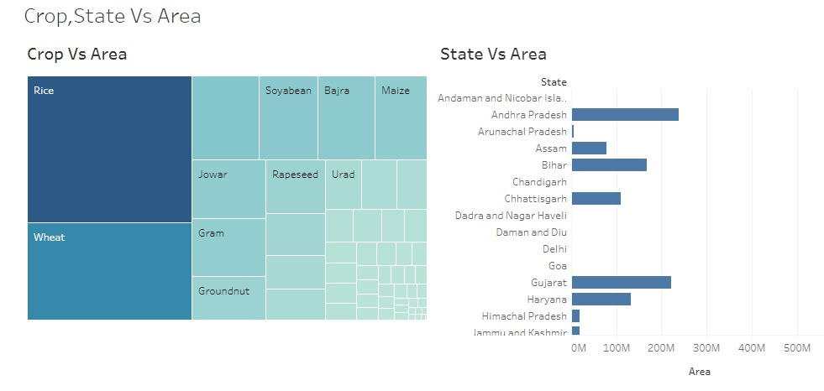
DASHBOARD 1

Slide 8
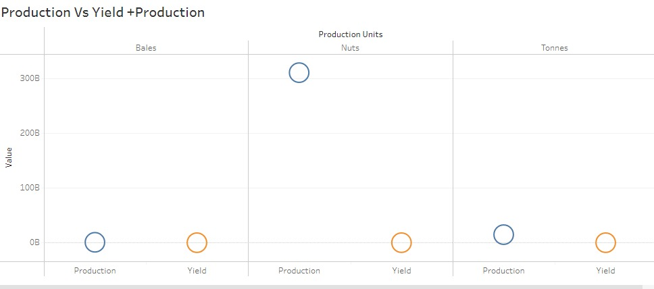
DASHBOARD 2

Slide 9
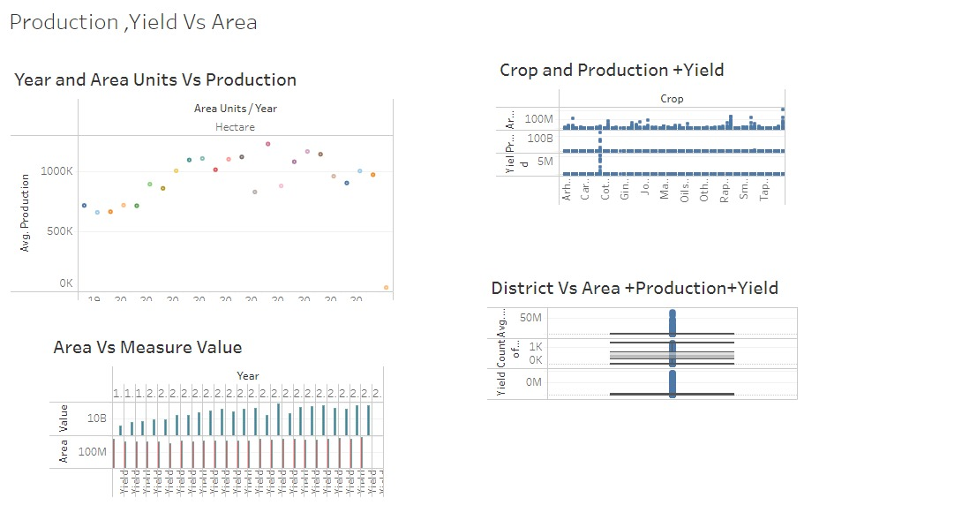
DASHBOARD

Slide 10
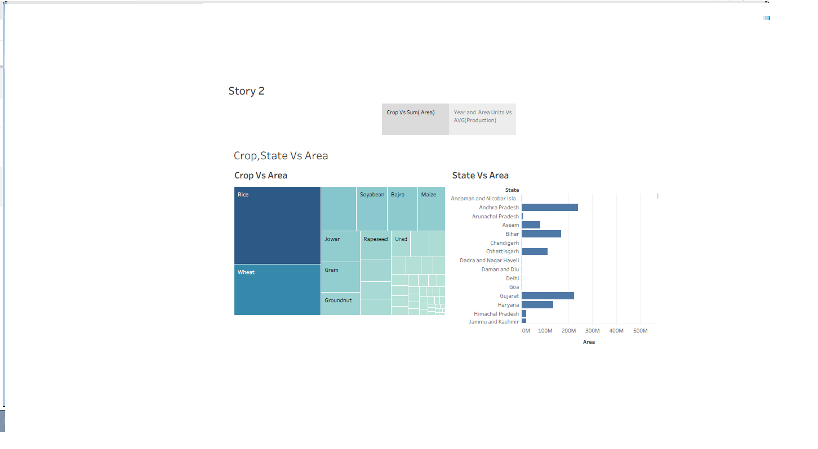
STORY 1

Slide 11
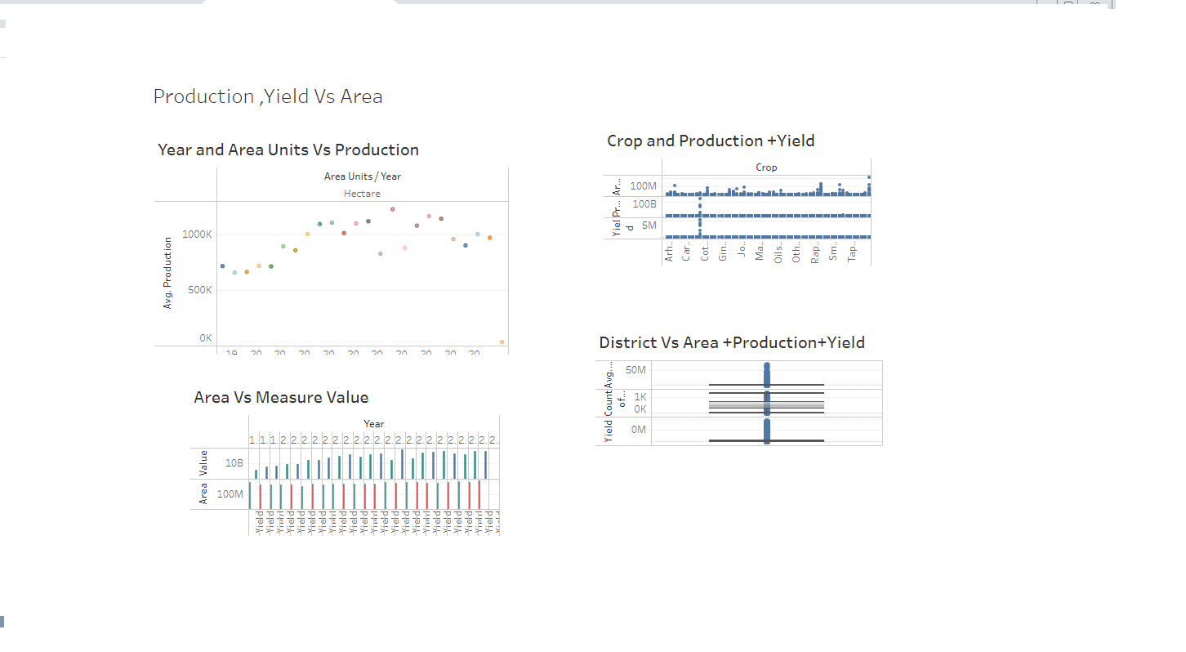
STORY 2

Slide 12
DISADVANTAGE
One of the major problems of organic farming method is that sometimes it can get a bit closely. Some product related to organic farming are too expensive, leading to some common people do not be able to afford.
Organics farming is sector that requires a lot o patience. This is because pests and others obstacles must be.

Slide 13
APPLICATION OF INDIA’S AGRICULTURAL CROP PRODUCTION ANALYSIS 1997-2021
Agriculture plays a significant role in India's growing economy.
With around 54.6% of the total workface involved in agriculture and allied sector activities the sector contributes to 17.8% of the country’s gross values added.
Agriculture 4.0 is a considerable advanced version of precision farming method.

Slide 14
CONCLUSION
Agricultural sector is vital importance for the region India's agricultural sector is still very importance to the Indian economy.
Although its share of the economy has decreased over the past 50 years.

Slide 15
THANK YOU

